Slide 1
great outdoors Group-b
By
Ayush Agrawal

Slide 2
EPIC AND USER STORY
Initialize Return Order
Validate And Check
Purpose Of Return
Confirmation of Return
Generate Return Id
Generating Return Reports
Return Online Order

Slide 3
EPIC AND USER STORY
Adding, Updating , Deleting Sales Person Details
Generating Sales Person Id
Generating Sales Person Target Report
Sales Person Details

Slide 4
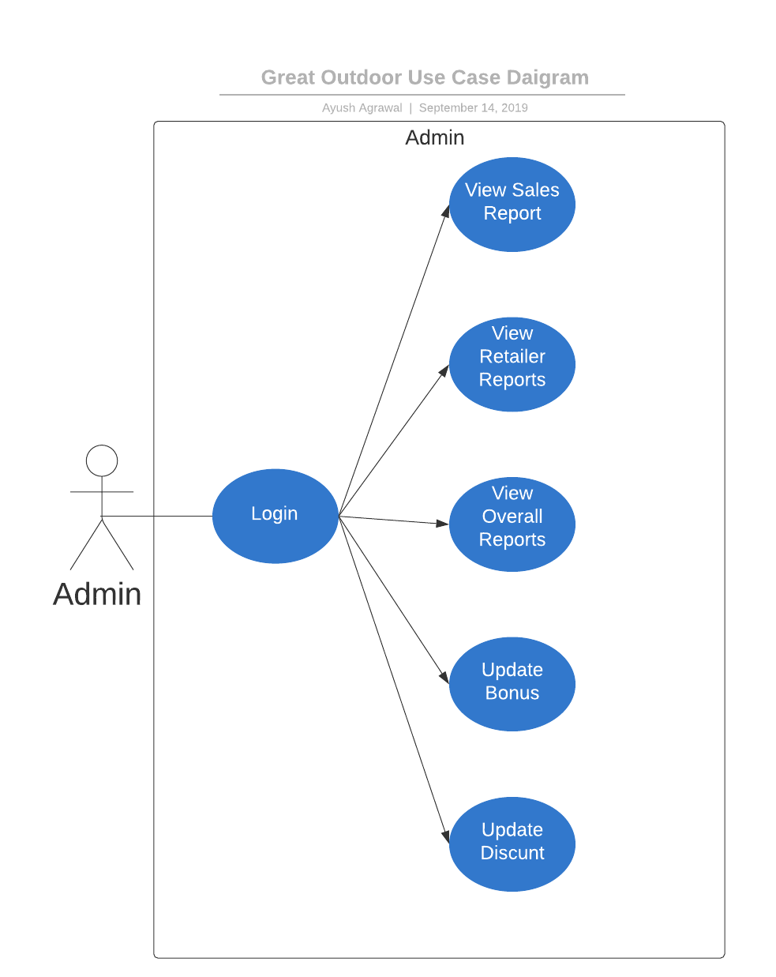
Use CASE DIAGRAM

Slide 5
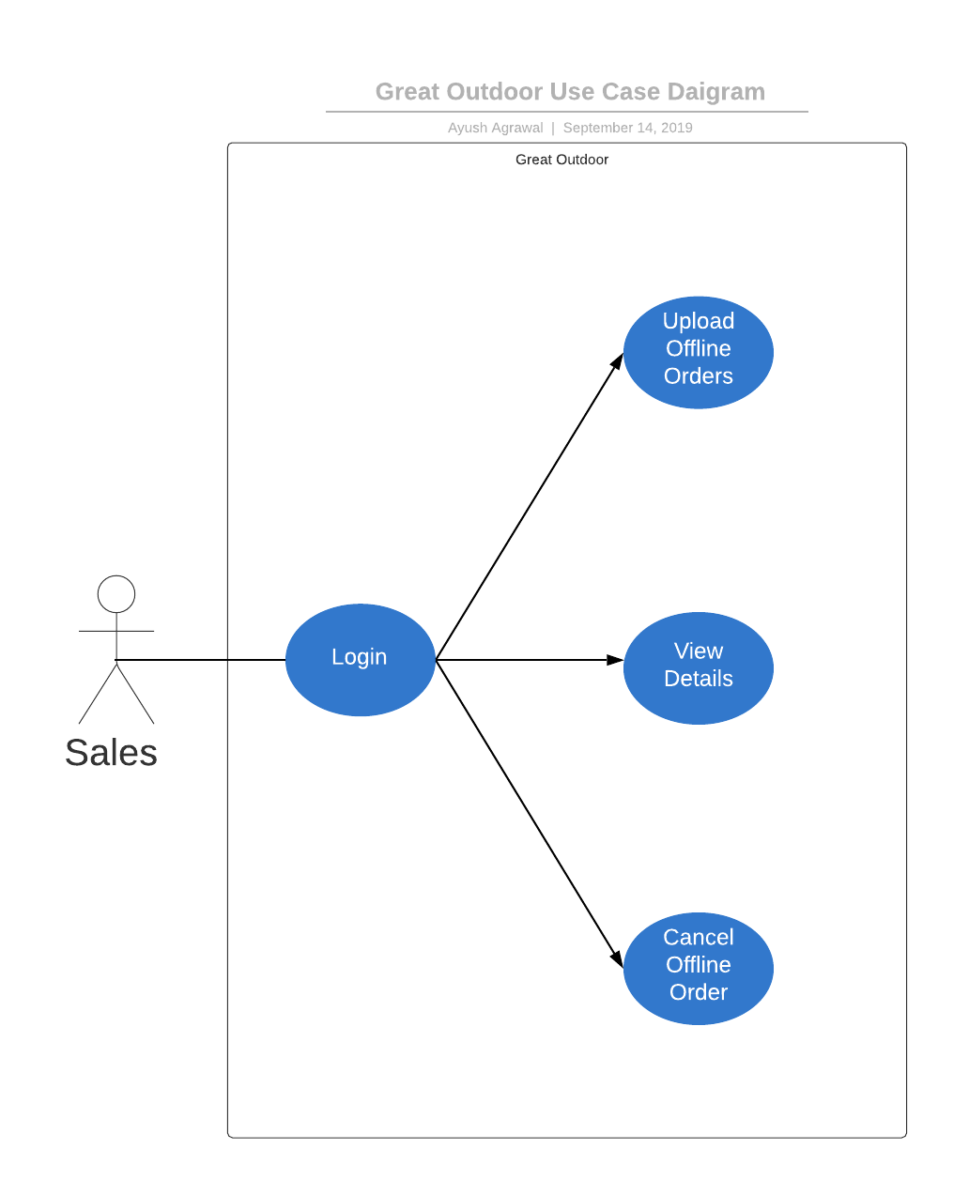
Use CASE DIAGRAM

Slide 6
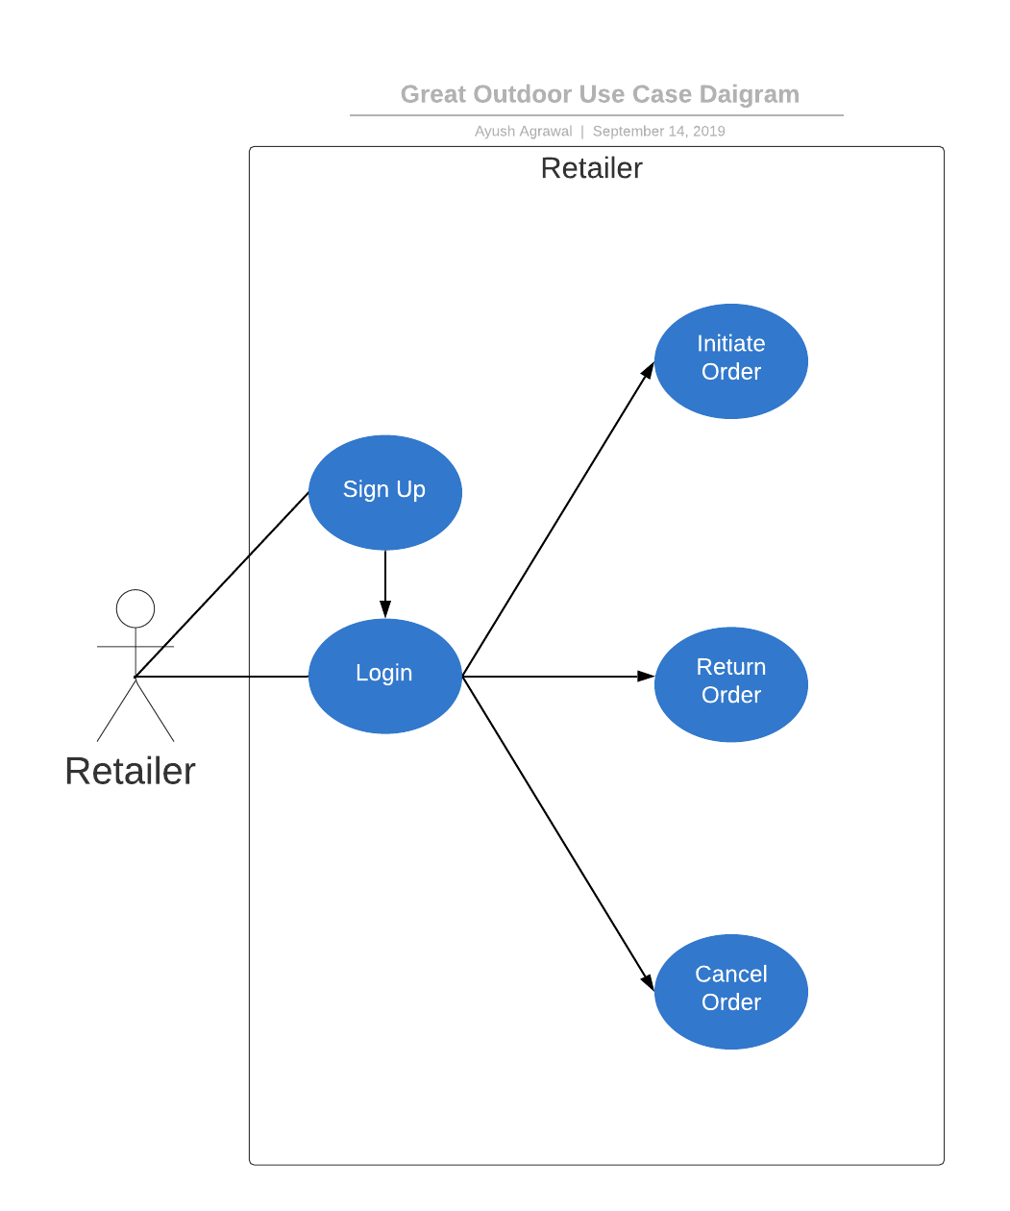
Use CASE DIAGRAM

Slide 7
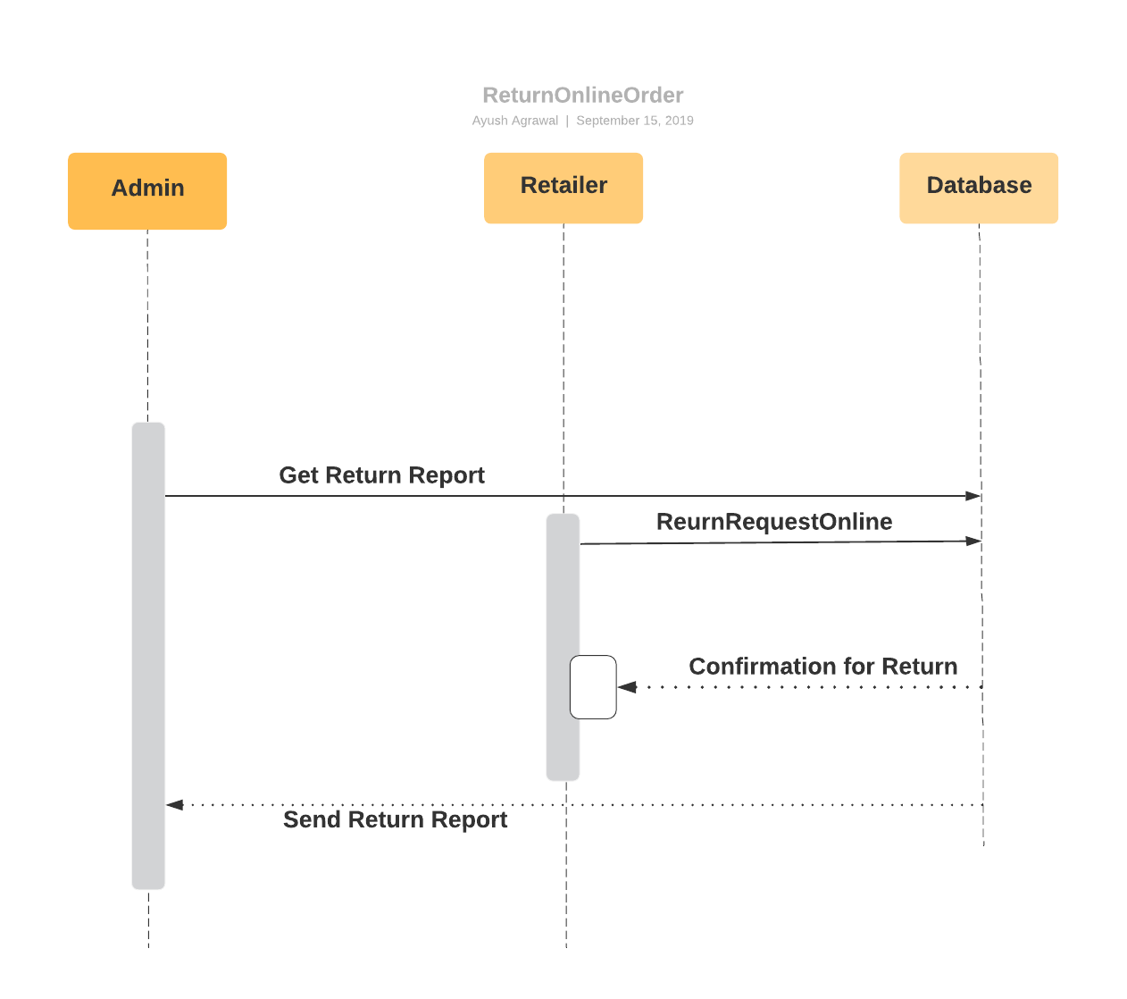
Sequence Diagram for Online Return Order

Slide 8
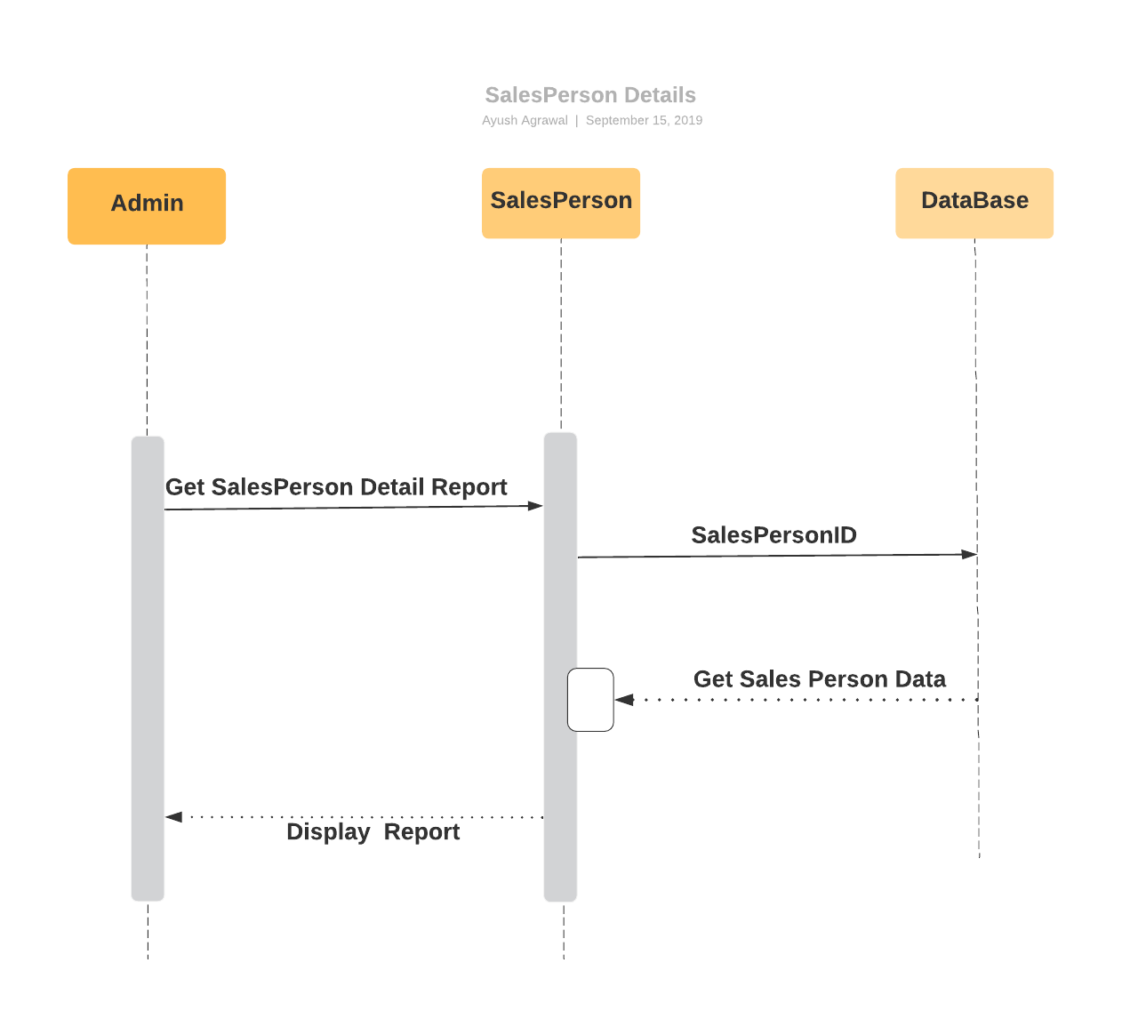
Sequence Diagram for Sales Person Details

Slide 9
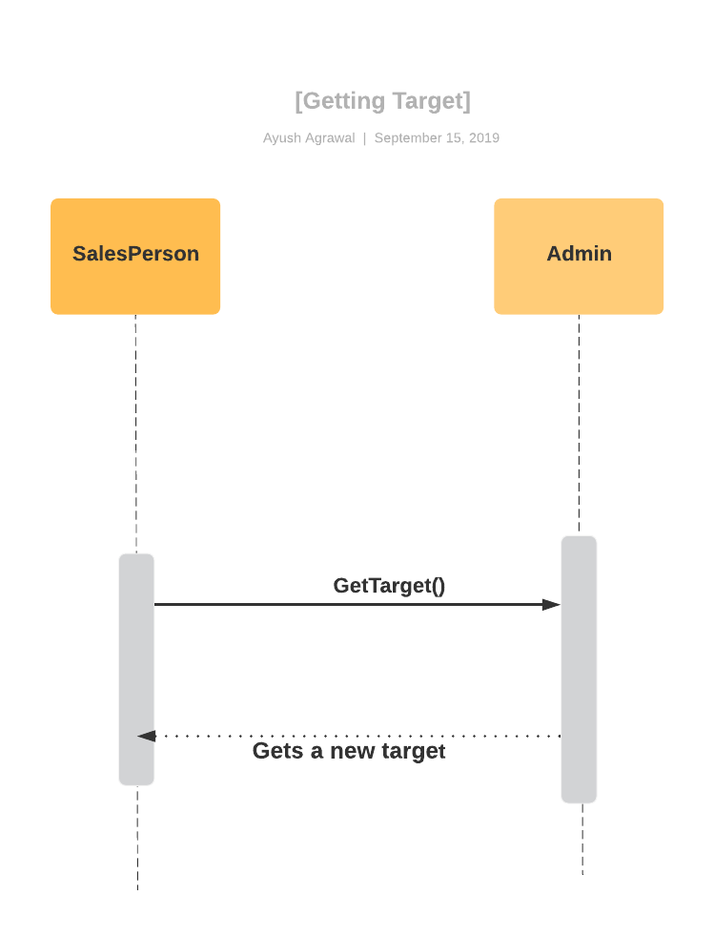
Sequence Diagram for Getting Sales Target by Sales Representatives

Slide 10
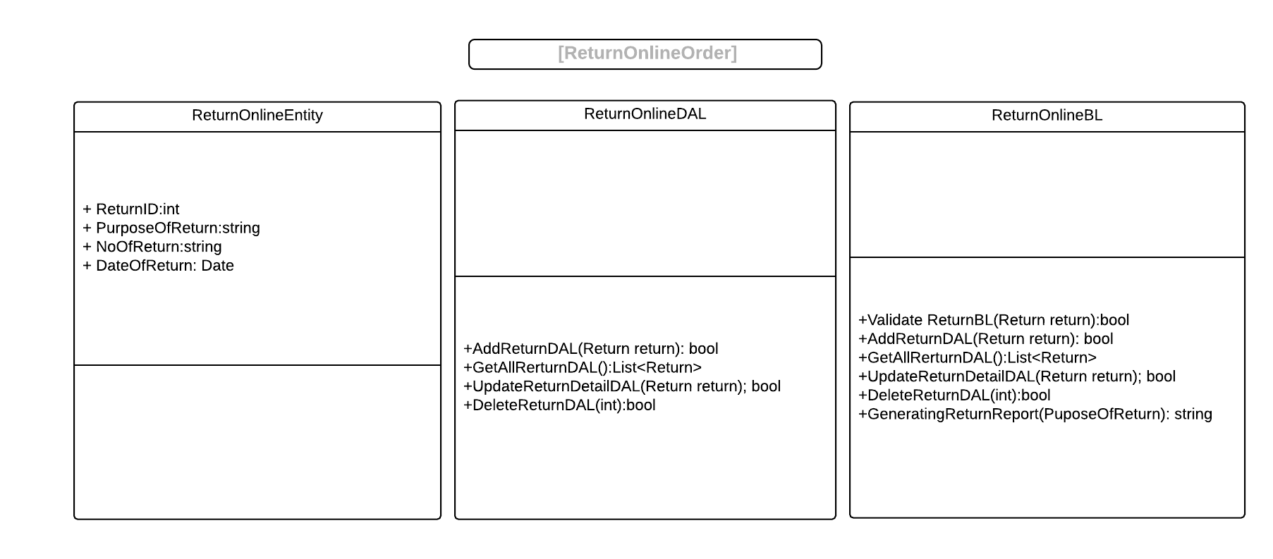
Class diagram

Slide 11
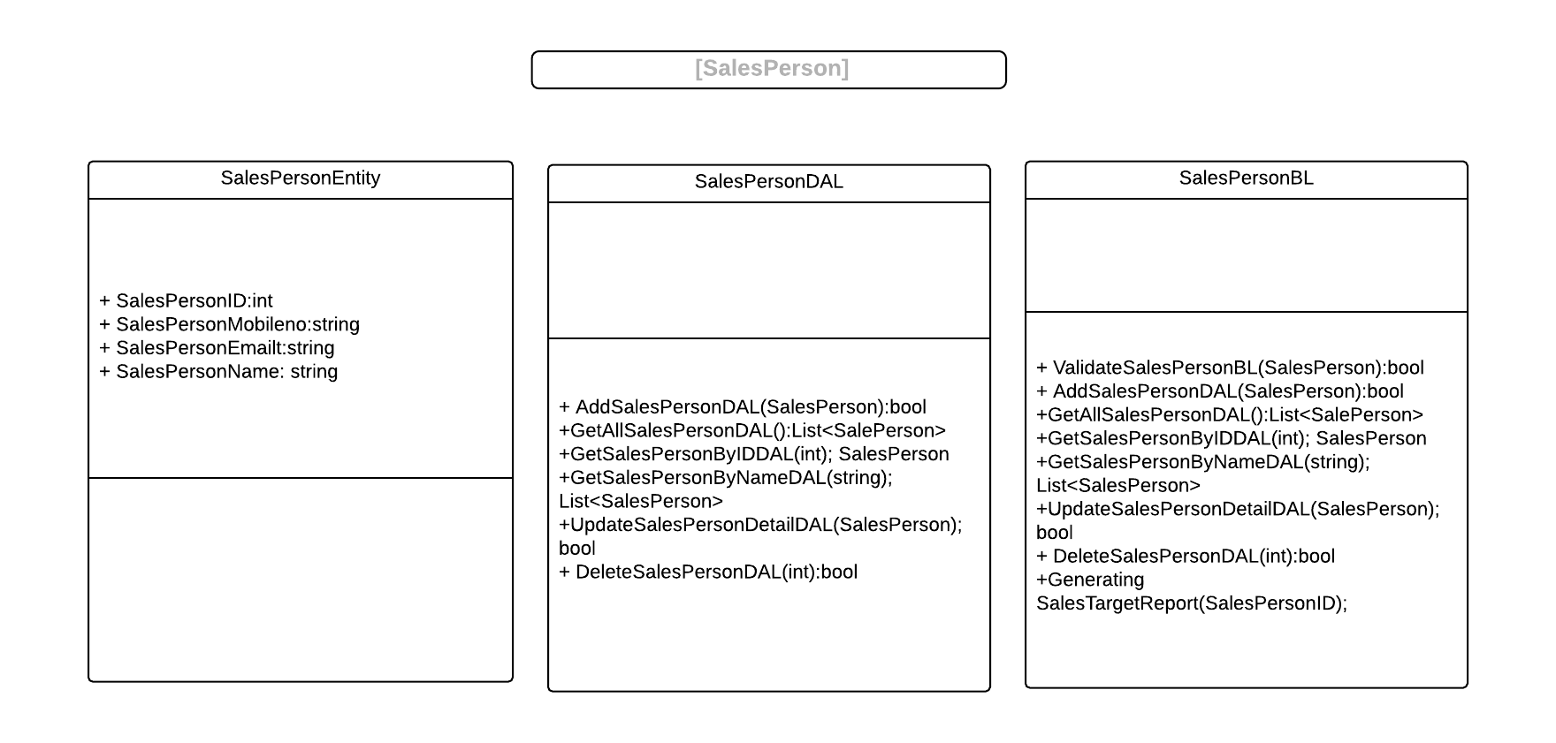
Class diagram

Slide 12
Thank you

